Slide 1
Using Sensor Data
NC 812/ESD 812

Slide 2
Analyzing Sensor Data
Single Sensor Data:
Improving the reliability
Tools to analyze the sensor data
Multiple sensors, same parameter
Multiple Sensors, different parameters

Slide 3
Sensor Data
As discussed earlier, the data received from the sensors may not be accurate and may need some pre-processing.
The factors to be taken into account:
Noisy data
Sensor accuracy/precision
Dependence on previous state of the sensor
Time lags in measurements
Etc.

Slide 4
Sensor Data Noise
Sensor noise is caused by errors in the sensors and the transmission of the signals. Sensor noise includes spikes as well as high frequency variations.
High frequency variations include hum at frequencies that are a multiple of the power supply frequency. Spikes in signals occur from many sources and are picked up by the instrumentation and its wiring.
Inadequately shielded sensors or their transmission lines, and variables transmitted through wireless links are vulnerable to radio frequency interference, leading to spikes, and pickup of other noise such as electrical hum.

Slide 5
Filtering
Filters are used to reduce high frequency noise and “spikes” for single variables or the “low-pass” filters. Low frequency errors such as bias errors require analysis using multiple variables.
A signal from one sensor might be used unfiltered for some analyses, and with several different filters for other purposes. This depends on the types of noise, the process and noise frequencies of interest, and the failure modes being considered.

Slide 6
When Not to Filter
When:
Some diagnosis is to be made based on time series analysis,
Need to recognize the presence or absence of noise,
Need to detect unusual dynamic behavior, as a symptom of a fault.
For example, to detect a frozen sensor value, we need to look for an unchanging value using a time series calculation such as standard deviation.
In other diagnostic applications, one symptom is the presence of cycles while in closed loop control. Filtering will make this harder to see.

Slide 7
Spike Filter
The purpose of a spike filter is to suppress extreme changes in measured variable values, since they probably don’t reflect actual changes in the monitored process.
Small input changes are passed through without modification.
In case the extreme change remains in place n times in a row, then the change must be accepted as real.
.

Slide 8
Spike Filter
When using a spike filter, it should be placed first in the signal path, ahead of any other filter. That way, it can be tuned independently of the other filters. Other filters would dampen the spike to an extent dependent on their tuning. In normal conditions, operation of the other filters remains unaffected because the spike filter passes through routine small variations without modification.
A simple spike filter has two parameters, M and n. M is a maximum change parameter. M is set so that in normal operations, the input does not change by as much as M from one time step to the next. The parameter n is the number of extreme changes in a row that will be rejected before finally accepting a large change, with possible values n=0,1,2,…

Slide 9
Dead-band Filtering
For diagnostic systems there is a filtering opportunity at the point where analog data is converted to discrete states or events.
This is widely used even in the simplest alarm systems by specifying a “dead-band”. Consider a high level alarm. As a level sensor increases in value from its normal range to a high value, at some point it crosses an alarm threshold x and a high-level event is generated.
If the average sensor value is near x, with high frequency noise, the alarm would constantly be generated and removed, requiring repetitive acknowledgment. Instead a dead-band of size d is used, so that the alarm is not removed until the level signal falls below the value x - d. The dead-band parameter d is chosen so that it is larger than the variations caused by typical noise.

Slide 10
Input Sampling: Aliasing
Aliasing is a problem that arises from slow sampling. When data is sampled at discrete points in time, faster sampling make it possible to accurately see higher frequencies and faster changes in signals.
If the sampling rate is inadequate, aliasing will make the high frequencies appear as if they were lower frequencies. The noise at those higher frequencies is not eliminated -- it is just converted to lower frequency noise.

Slide 11
Example
Consider an event being observed by your system. The closest two events can occur are10 ms apart.
How often should you record this event? The sensor readings are expected to be noisy.

Slide 12
Averaging Filter
Let the sensor reading be represented as:
x(k)=s+n(k)
Where s represent the actual attribute value that is being measured (so called signal) and n(k) represents the overall noise present in the system. There can be several sources of noise; instrument noise, measurement noise, environmental noise, thermal noise etc.
Using CLT, the noise can be assumed to have Gaussian distribution N(μ,σ²)

Slide 13
Averaging Filter
The noise average value represents the bias and it can removed relatively easily if it time invariant.
The variance makes the system imprecise, resulting in inaccurate/unreliable readings.
One of the easy ways to reduce the noise variance is averaging.
Assuming that bias is computed and removed from measurements, the noise can be made zero mean

Slide 14
Averaging Filter
Since the attribute to be measured in deterministic unknown (not random), the measurement x, can be modeled as a Gaussian distributed random variable
X ~N(s,σ²)
Where “s” is the value of the attribute we are trying to measure. The measurements are taken at N time instances and averaged,

Slide 15
Averaging Filter
The original attribute value will remain the same and the new noise component will follow Gaussian Distribution
N(0,σ²/√N)
Larger the value of “N”, better is the reduction variance and improvement is measurement precision.

Slide 16
Types of Filters
A filter takes an input signal x over time, processes it, and produces a filtered output signal y. The filter output may depend on current and some previous values of x. These are indicated as x(k), x(k-1), ... . Filter implementations store previous values of inputs or outputs in memory, depending on the type of filter.
Based on Frequency: Low-pass, high-pass etc.
Based on impulse response length: FIR, IIR
Noise Removal: Wiener, Kalman, Savitzky–Golay smoothing filter etc.

Slide 17
AR/MA Filters
In the terminology of time series analysis, two major filter categories are autoregressive (AR) and moving average (MA).
Moving average filters depend only on the current and previous inputs x(k), x(k-1). For a linear moving average filter, the output is a weighted sum of a set of recent inputs. The most familiar “simple moving average” has equal weights (whose sum equals 1.0).
Autoregressive filters such as the exponential filter depend on previous output values y(k), y(k-1), ... , as well as the current input value x(k).
Filters that use both previous inputs and outputs are called ARMA filters.

Slide 18
FIR/IIR Filters
Impulse Response of a filter is defined as the response to an impulse input, which is the theoretical limiting case of a very brief spike in the value of the input. An autoregressive filter is called an Infinite Impulse Response (IIR) filter. A moving average filter is called a Finite Impulse Response (FIR) filter.
This terminology emphasizes the finite vs. infinite “memory” of a filter: how long do the effects last after a change in input.
In the case of an autoregressive filter, because of the feedback from output back to input, the effects last forever. In IIR filters such as the exponential filter, the effect of an old sampled input decays exponentially over time.

Slide 19
Exponentially Weighted MA Filter
The name comes from the concept that the filter’s output, y, is the weighted average of the current input and each previous inputs, with the weighting decreasing exponentially:
Y_{t} = (1-α) X_{t} + α X_{t-1} + α² X_{t-2} + α³ X_{t-3} + ….
where Y_{t} is the current output from the filter, and X_{t} is the current input, and the other X’s are each preceding value.

Slide 20
EWMA
This averaging tends to smooth out the response and reduce noise. It can be rewritten as a recursive formula using the past output from the filter:
Y_{t} = α Y_{t-1} + (1-α) X_{t} for all values of t > 0,
or, re-arranging terms:
Y_{t} = X_{t} + α ( Y_{t-1} – X_{t})

Slide 21
Value of α
Value for α can be anything ranging between 0 and 1. At 0, the output is just the raw input: no filtering occurs.
At 1, the output becomes equal to the past value: it never changes, eliminating all noise and all real signal changes! Clearly one wants to select a value in between these extremes.
The correct value depends on situation. The higher the a, the more noise if filtered out, but also the more lag that is introduced in reacting to real system changes.

Slide 22
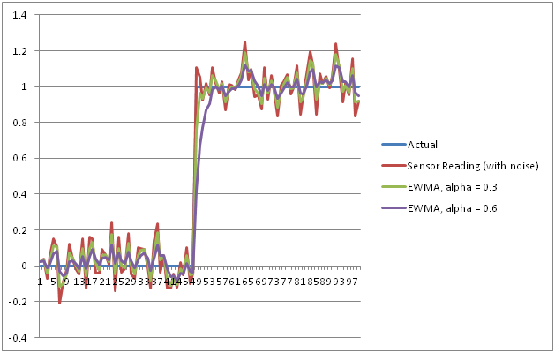
Example

Slide 23
Moving Average Filter
The simple moving average filter averages recent values of the filter input for a given number of inputs. This is the most common example of the “moving average” (MA) category of filters.
The sum of the coefficients is 1.0, so that the output eventually matches the input when the input doesn’t change. Its output just depends on recent inputs, unlike the exponential filter that also reuses its previous output. The only parameter is the number of points in the average - the “window size”.

Slide 24
Moving Average Filter
Both the filters discussed earlier are generic. For most applications, these filters are sufficient. However, for more involved systems, a better filter needs to be used.
For example, for heart rate monitoring using an accelerometer, chest acceleration signal as picked up by the accelerometer has a rather slow varying, but very strong (20-50 peak-to-peak) motion component.
Riding on top of this motion signal, is a higher frequency, but weaker (5- 10 peak-to-peak) heart sound signal.
The problem of isolating the weaker heart sound signal after suppressing motion is not a trivial one. Wavelet transforms, Fourier transforms don’t work.

Slide 25
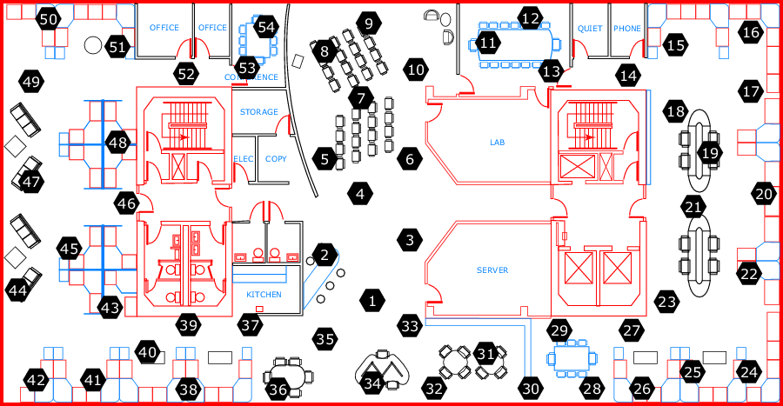
Example

Slide 26
Temperature data from Sensor 1

Slide 27
Observations from the Data

Slide 28
Simple LPF

Slide 29
Window of size 5

Slide 30
Correlation Coefficient

Slide 31
Wiener Filter Theory
The techniques for design of frequency selective filters were well defined. During world war II, Norbert Wiener considered a different sort of problem where there is significant overlap in the spectra of both the signal and noise.
In this case, it is obvious that no filter is going to yield perfect separation. The filter that gives the best compromise of passing the signal and at the same time, suppresses most of the noise is not at all obvious!
This was the problem examined by Wiener in the 1940s. Note that his concern wasn’t filter design but a more fundamental problem namely; what should the filter’s response be?

Slide 32
Wiener Filter Theory
This theory is loosely referred to as Wiener Filter Theory. It is characterized by the following assumptions.
Both the signal and noise are random processes with known spectral characteristics or equivalently, known auto- and cross-correlation functions.
The criterion for best performance is mean square error. The desired filter should minimize the error in the mean square sense. This is partially to make the problem more tractable mathematically but it is also a good physical criteria in many applications.

Slide 33
Criterion for Statistical Optimization
Since the filter coefficients are to be determined such that the solution optimum statistically, there are several criterion that are possible.
Most intuitive idea is optimizing the filter design by minimizing a cost function or index of performance. The cost function would depend upon the error, which is difference between the actual and desired output.
Mean square value of the estimation error.
absolute value of the estimation error.
Fixed error based on value.

Slide 34
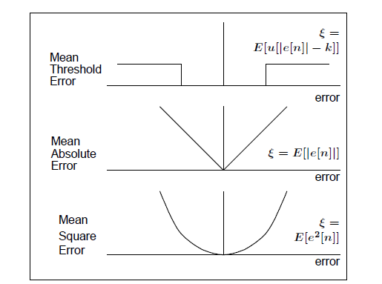
Estimation Error

Slide 35
Model for Linear Estimation Problem
Consider the model for linear estimation problem shown below.
The input signal consists of the desired signal and random noise. Objective is to design an optimum linear time-invariant filter with impulse response h(n) that suppresses the undesired interference (noise) while preserving the characteristics of the desired signal (s(n)).
s(n)
x(n)
y(n)
Optimum
Linear filter
h(n)
+
-
e(n)
signal
w(n)
noise
d(n)
desired signal

Slide 36
Model for Linear Estimation Problem
There are three special cases depending upon how d(n) is related to s(n):
if d(n)=s(n), the linear estimation problem is called filtering.
if d(n)=s(n+D), where D>0, the problem is that of linear prediction.
if d(n)=s(n-D), where D>0, the problem is that of signal smoothing.
Minimization of the mean-square error E{e²(n)} is selected as the criterion for optimizing the LTI filter h(n).
We assume that s(n), w(n) and d(n) are zero mean and wide-sense stationary random processes. The optimum filter, in the sense of MMSE, is called Wiener Filter.

Slide 37
Kalman Filters
Kalman filtering provides a much more general framework and solution for finding the optimal estimate for multiple state variables in dynamic systems, given any number of measurements.
The starting point is an initial estimate of state values and their uncertainty, a “state space” dynamic model for predictions (with “process noise” errors specified to account for uncertainty in the model), and a measurement model mapping states to measurements, including specification of measurement noise.
The initial estimate, process noise, and measurement noise are all specified as multivariable normal distributions with a mean vector and a covariance matrix.

Slide 38
Example
Goal is to process the sensor readings coming from few Phototransistors that are using to detect moving toy trains.
The values reported tend to change quite a bit, due to environmental noise and random room lighting changes. In a dimly-lit room, “off” is very close to zero (below 10), while “on” varies from around 250 to 500 depending on the particular LED and sensor. Sensor output is being sampled every two milliseconds (N=2)
What kind of filter should we use here? Do we need any more information?

Slide 39
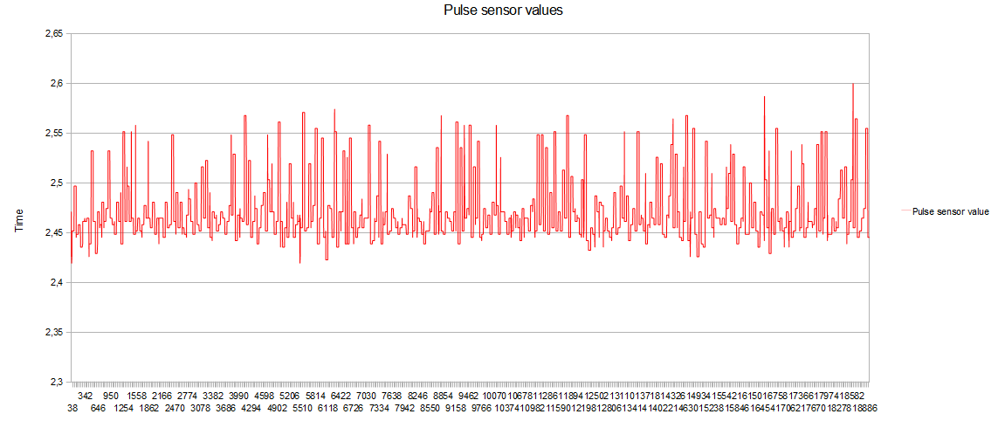
Example http://dsp.stackexchange.com/questions/9403/how-to-convert-raw-pulse-sensor-data-into-actual-pulse
How to convert raw pulse sensor data into actual pulse?

Slide 40
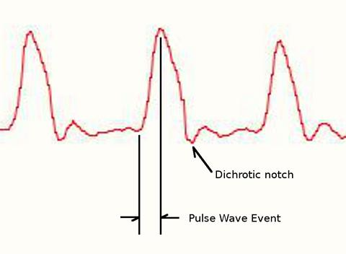
Example pulsesensor.com
The Pulse Sensor is a photoplethysmograph, which is a well known medical device used for non-invasive heart rate monitoring.
The heart pulse signal that comes out of a photoplethysmograph is an analog fluctuation in voltage, and it has a predictable wave shape.

